Slide 1
iStore
Mohamed Labbai

Slide 2
ABOUT PROJECT
iStore is a shopping app developed with Angular, nginx and JSON-Server-Auth technologies. It is a simple web application that contains Home page and the Mobile products listing page. Application user could be of Admin or User role. Based on the type of user logging in, app feature will be made available. For example, when Admin role is logging in then he will be able to add new product and modify existing products.

Slide 3
Features implemented
Following features have been implemented in this app development. JSON-Server-Auth nginx pipes Form handling Lazy loading of modules Routing, Child routing and params HTTPClient and Observables Angular Material Controls Service calls with secure end points (Token based auth)

Slide 4
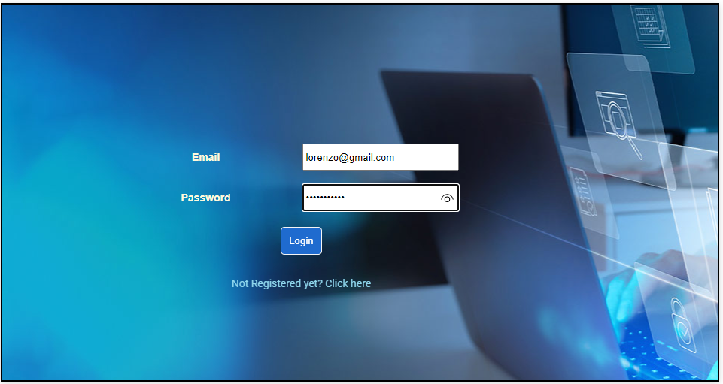
Login screen

Slide 5
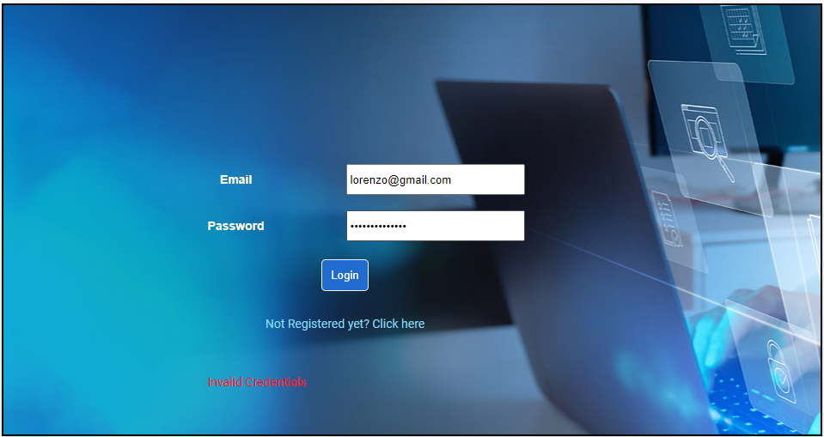
Login screen – Authentication failed

Slide 6
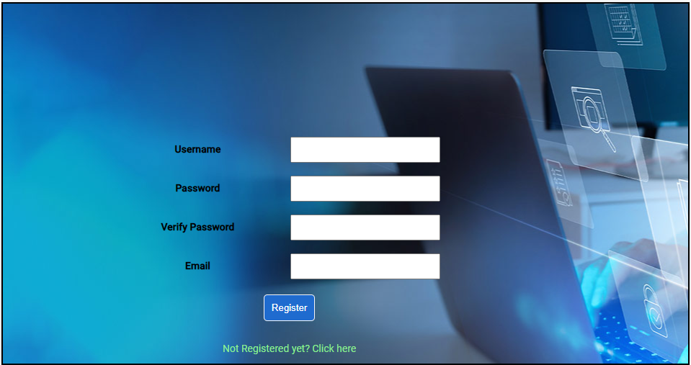
New User Registration

Slide 7
User Role

Slide 8
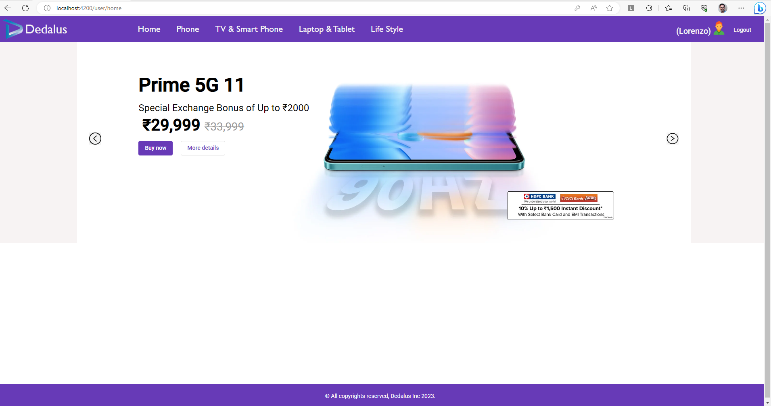
Home page (on Successful login)

Slide 9
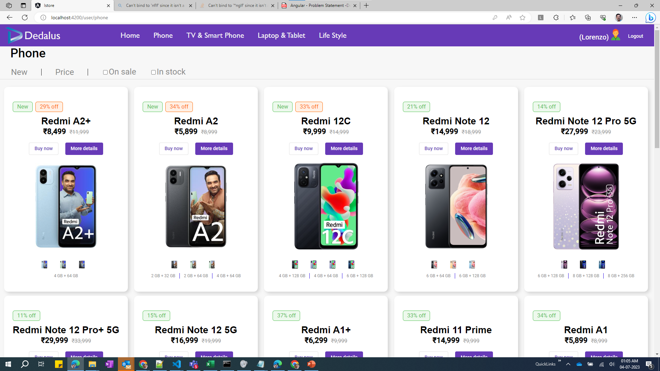
Product listing view

Slide 10
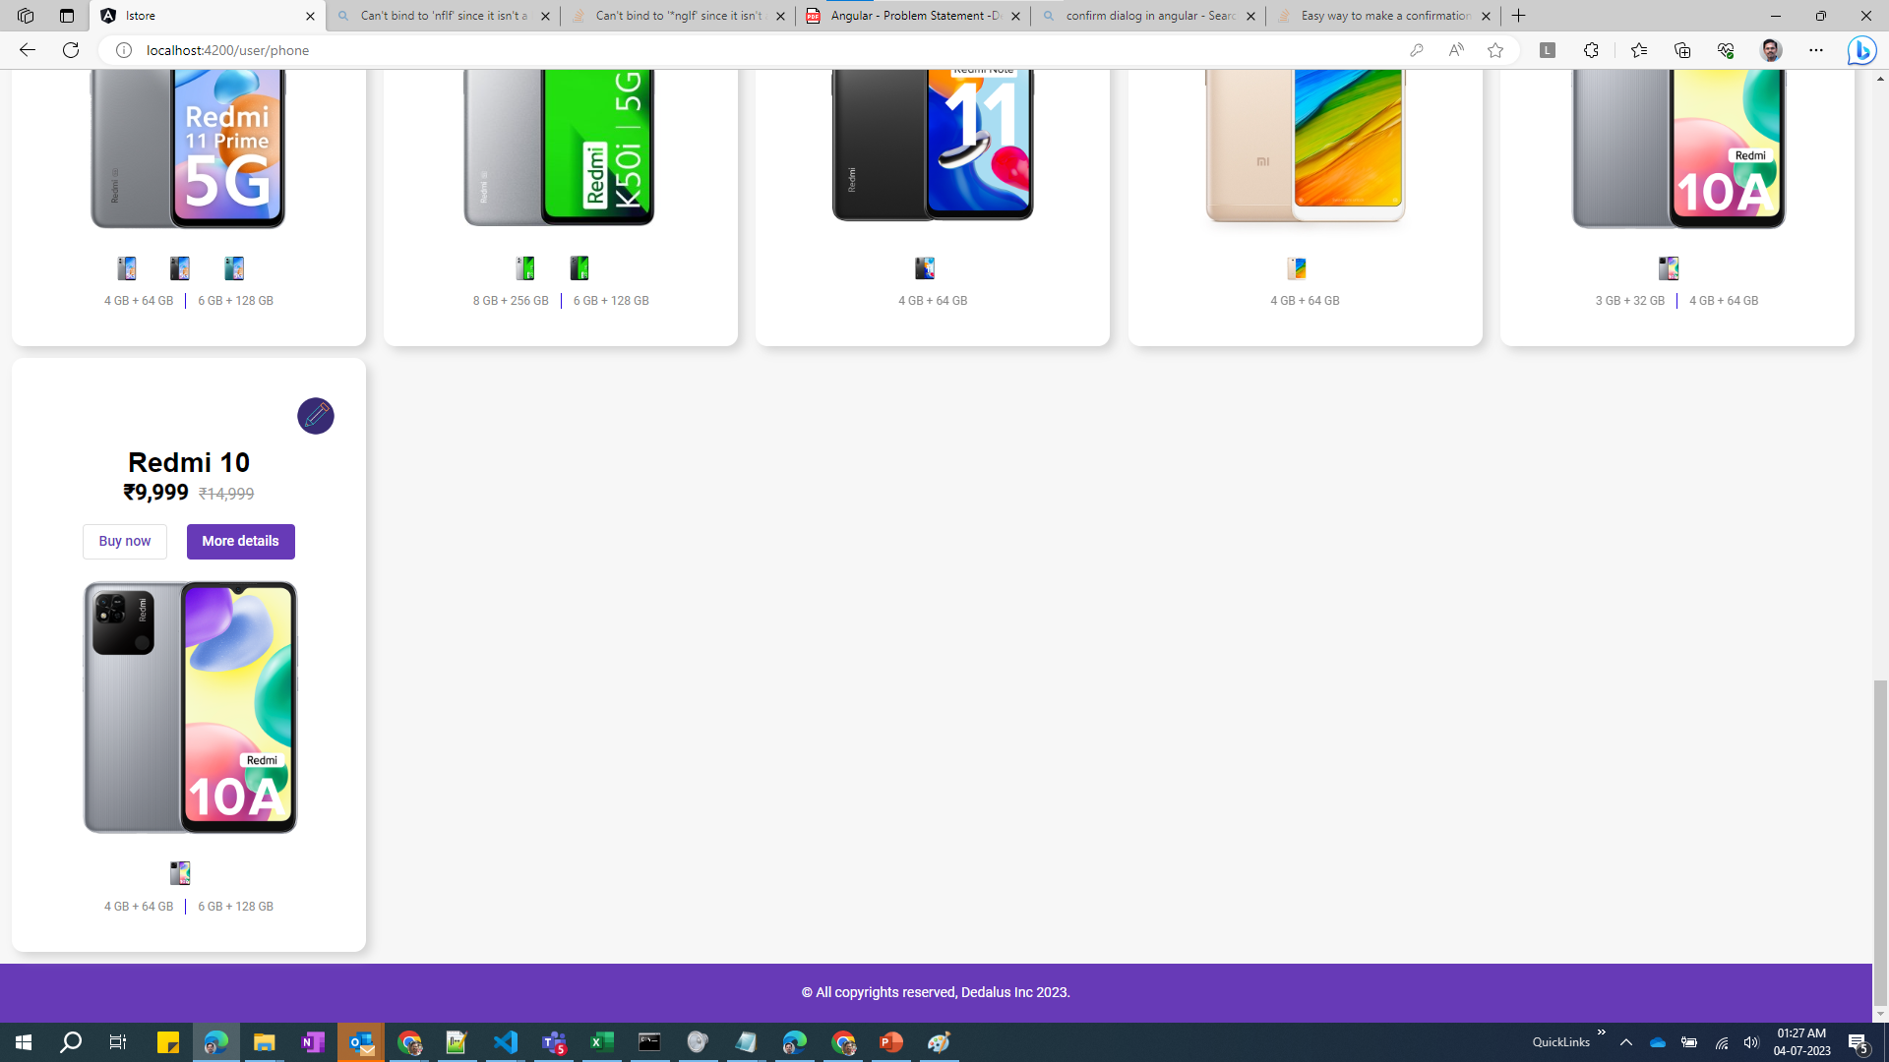
Product listing view (contd…)

Slide 11
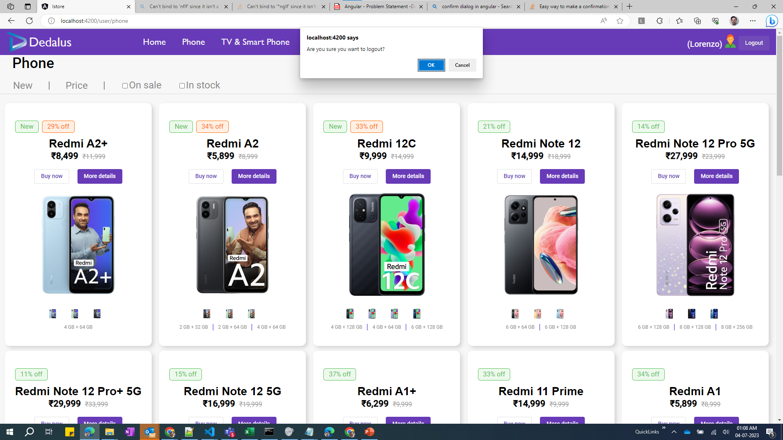
Logout confirmation

Slide 12
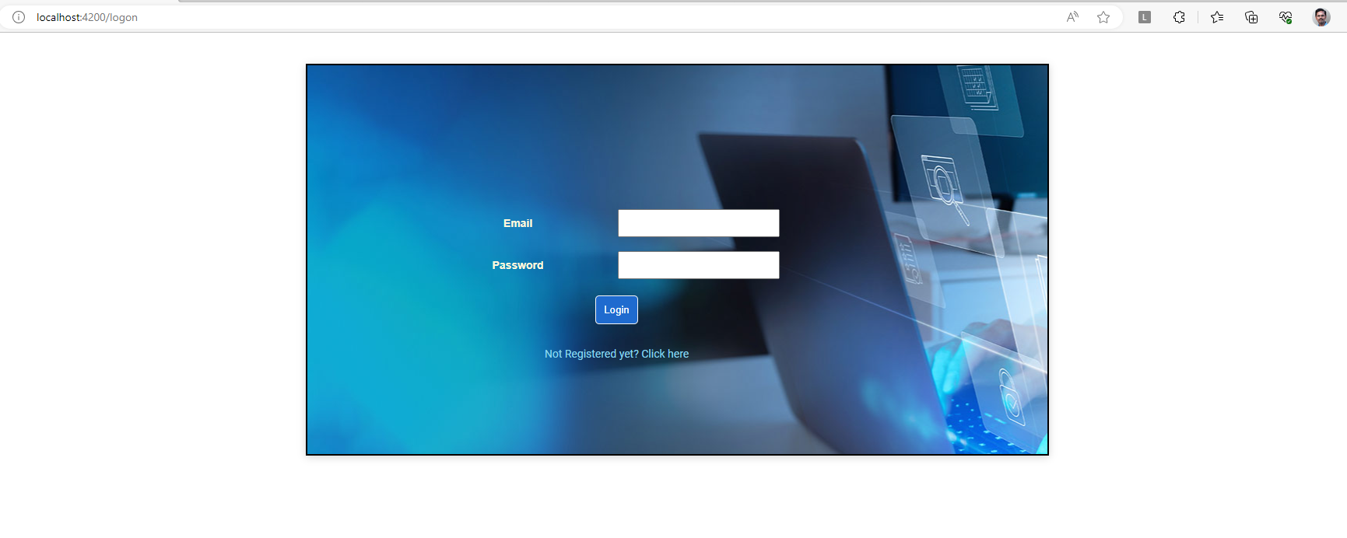
Logout
On successful logout, user is taken back to logon screen.

Slide 13
ADMIN Role

Slide 14

Login screen
Logging in with admin role user.

Slide 15
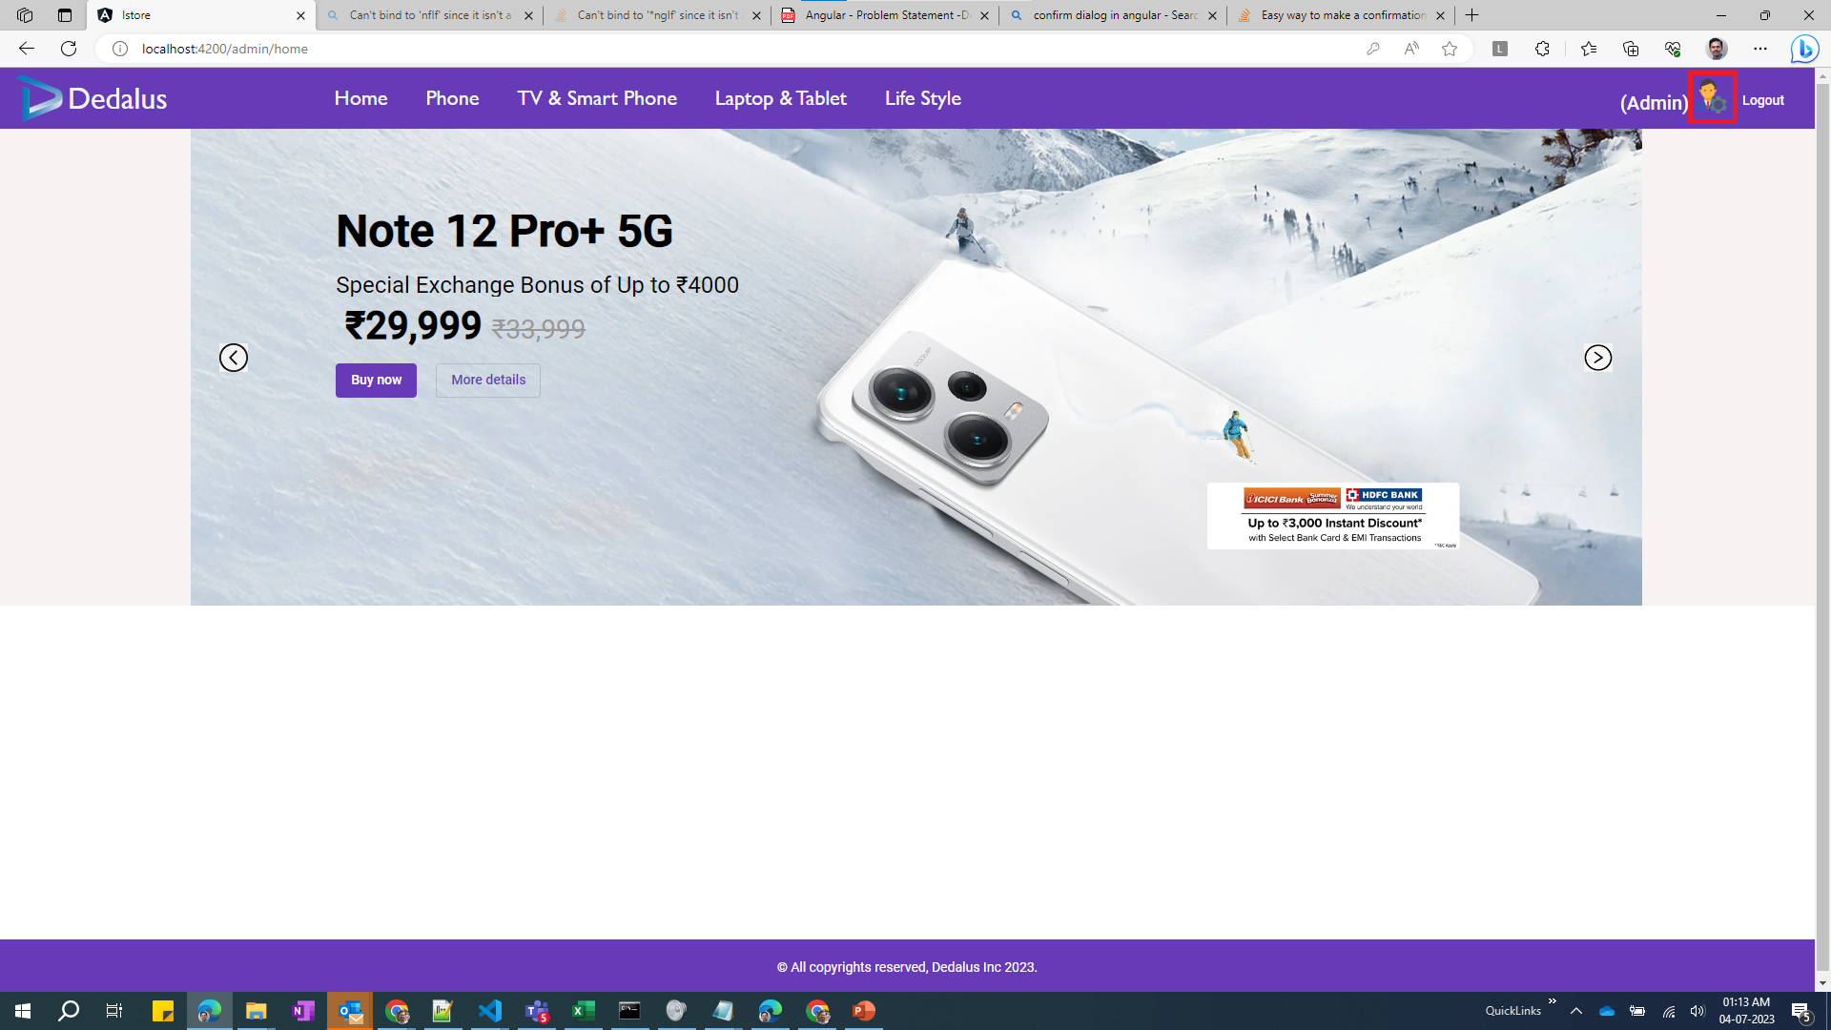
Login screen
Unique icon to indicate that user has admin role privileges.

Slide 16
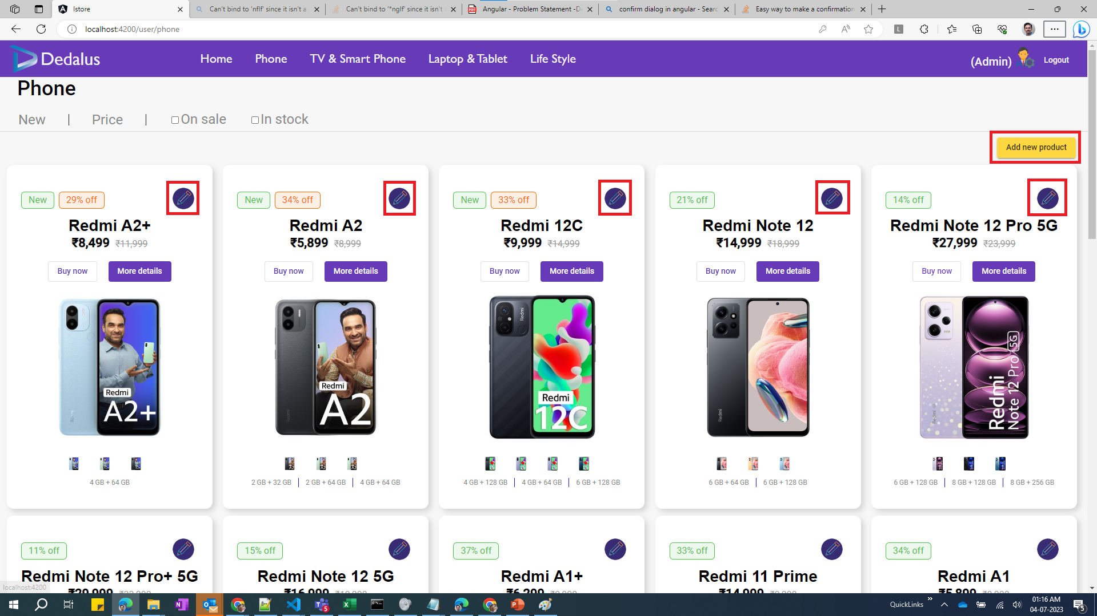
Login screen
Highlighted options would be available only for Admin role users.

Slide 17
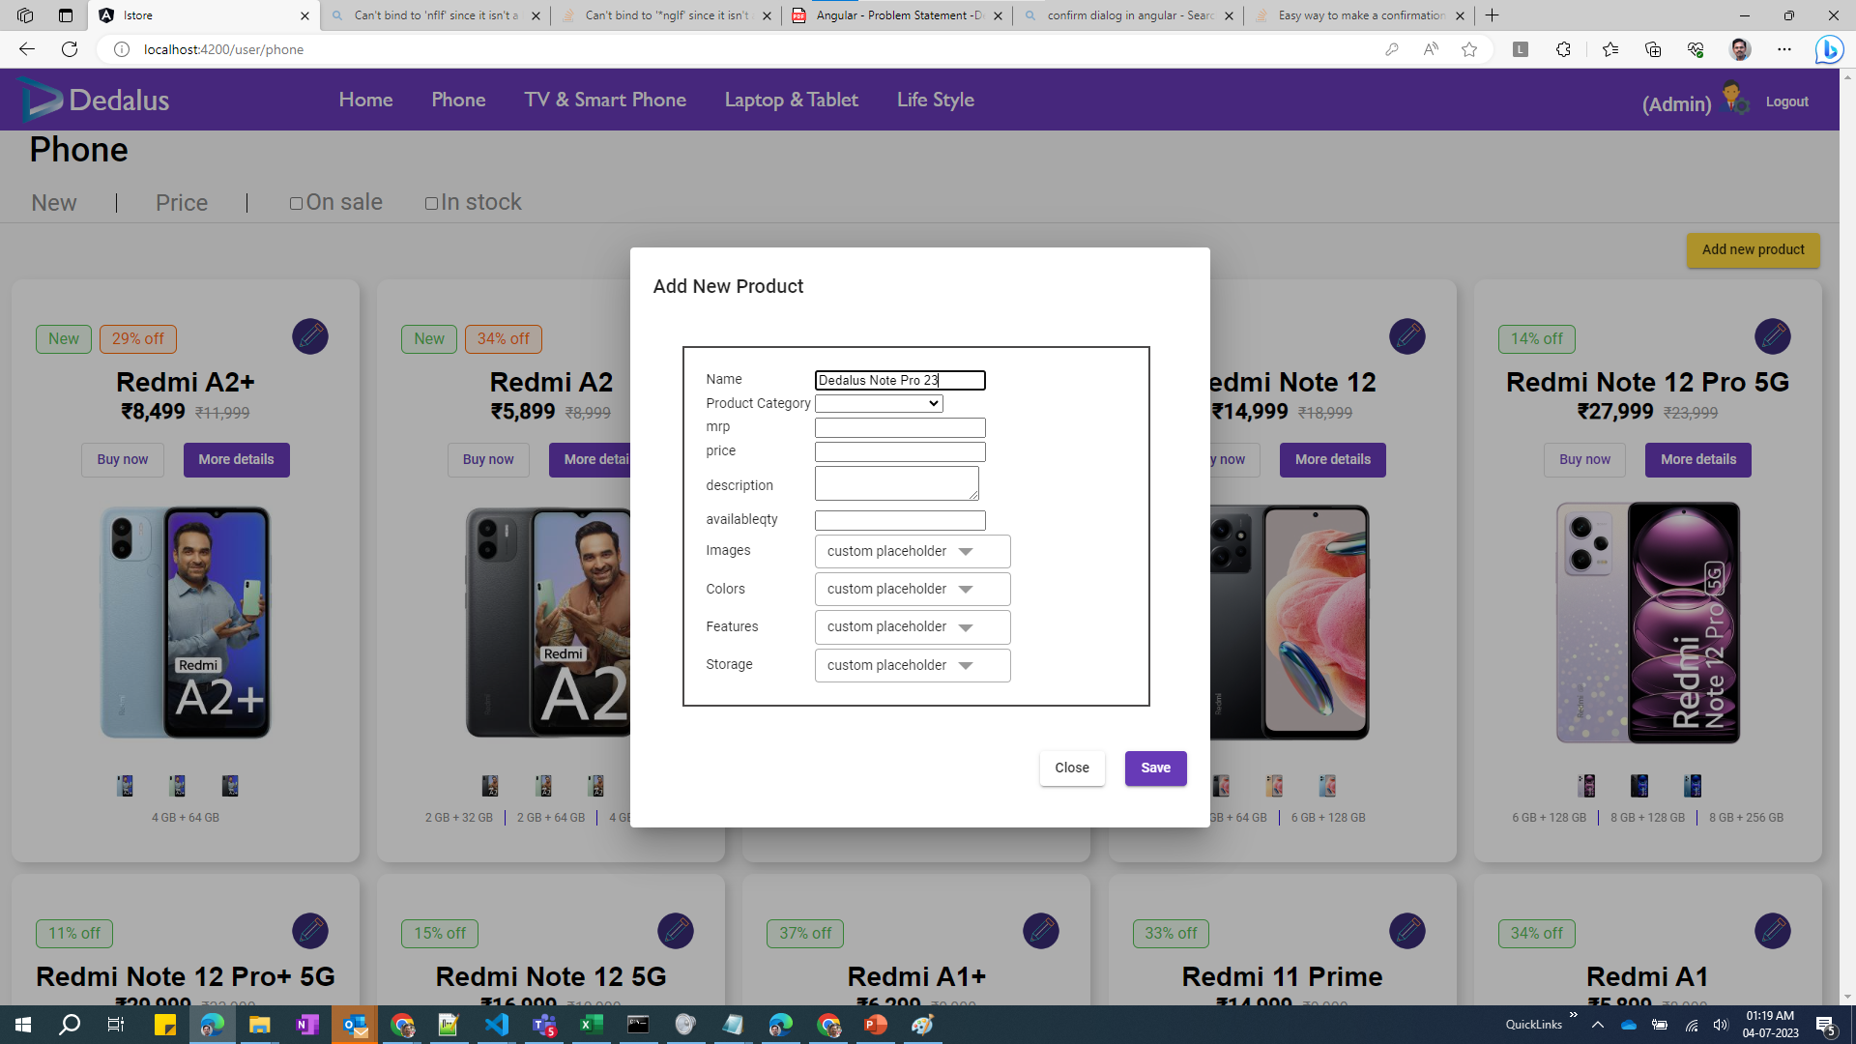
Login screen
On click of “Add new product”, a form will be opened wherein user can create a new product.

Slide 18
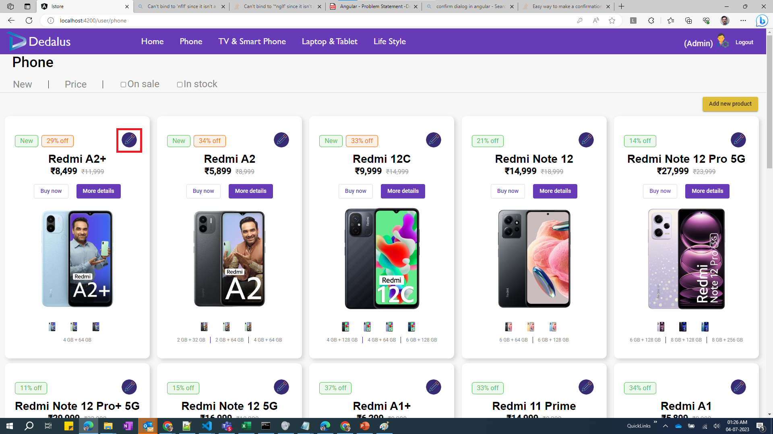
Login screen
Edit button to enable the user modify existing products.

Slide 19
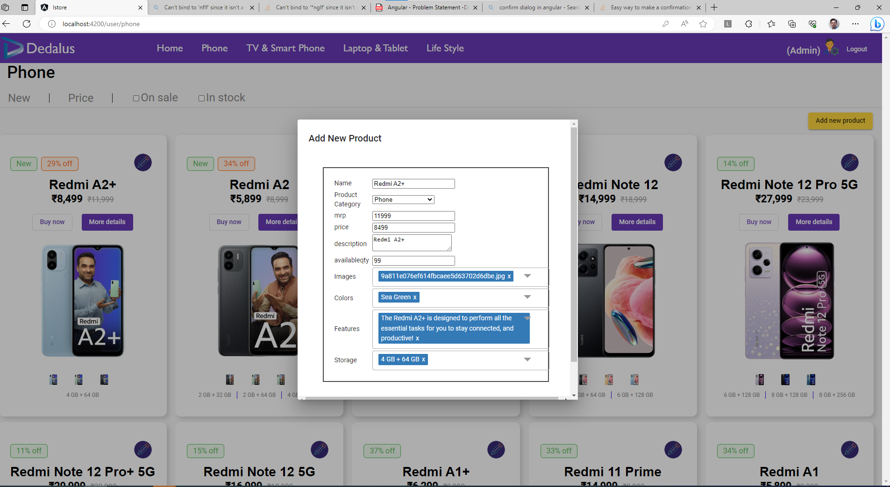
Login screen
On click of “Edit” button, a form will be opened wherein user can modify existing product.

Slide 20
THANK YOU
Mohamed Labbai
mabdulkhader@dedalus.com
https://www.dedalus.com

